Slide 1


SOLELY FOR PURPOSES OF FORAGE WORK EXPERIENCE
BRITISH AIRWAYS
Predicting customer buying behaviour
25-03-2025

Slide 2
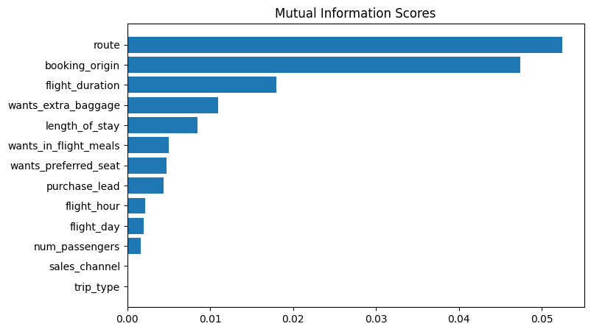
A predictive model using random forest classifier model is received
ACCURACY: 84.76
AUC score: 0.547
The top 5 features
1.route
2.booking_origin
3.flight_duration
4.wants_extra_baggage
5.length_of_stay
With an accuracy of 84.76%, the model correctly predicts customer bookings most of the time, but the AUC score of 0.547 indicates weak separation between positive and negative cases. This suggests that while the model is good at overall classification, it may struggle with edge cases or imbalanced data. The dominance of route and booking origin in feature importance highlights the need for region-specific strategies to improve conversion rates. Additionally, factors like extra baggage, flight duration, and length of stay suggest upselling opportunities. To enhance model performance, British Airways could focus on improving feature selection, balancing data, and testing alternative algorithms to better capture nuanced customer behaviors.

